Slide 1
한국어 지부
An Overview of OSGeo Korean Language Chapter
6th, Nov 2011
FOSS4G 2011 Tokyo Presentation
OSGeo Korean Language Chapter
Shin, Sanghee(endofcap@gmail.com)

Slide 2
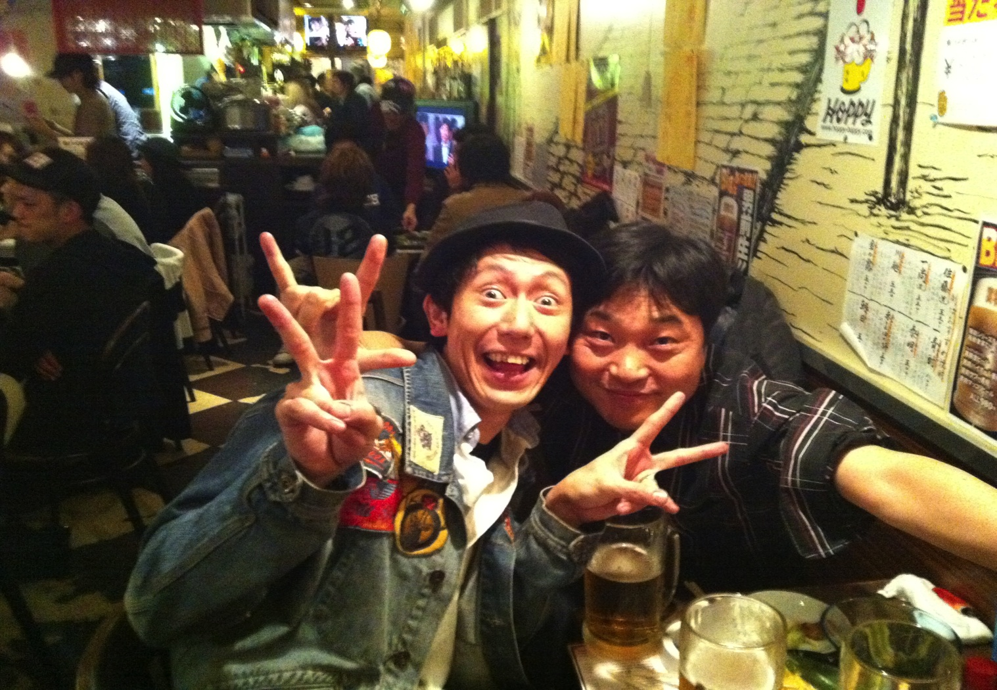

Slide 3
Overview
Mission :
Nurture and promote the Open Source GIS and Open GeoData in Korean language society
Objectives :
Encouragement and Promotion of Open Source GIS Software
Participation in Developing Open Source GIS Software
Translating Open Source GIS Software and its Documents into Korean
Supporting Users and Developers of Open Source GIS Software
Holding a regular meetings of OSGeo Korean Language Chapter
Initial Members :
Shin, Sanghee(endofcap at gmail.com) : Representative
Kim, Kunho(unicozy at gmail.com)
Yom, Jaehong(jhyom at sejong.ac.kr)
Heo, Min(heomin61 at gmail.com)
Lee, Chunseok(stoney at jinju.ac.kr)
Kim, Seongmin(poison77 at netsgo.com)
Kim, Seungyong(ksyspurt at gmail.com) : General Manager
Park, Seongwoo(raima at bntsolution.com)
Nam, Kwangwoo(kwnam at kunsan.ac.kr)
Kwon, Yongchan(unitave at gmail.com)

Slide 4
Overview
Members :
As of 25th, Oct 2011, we had 184 members in OSGeo Korean Language Chapter.

Slide 5
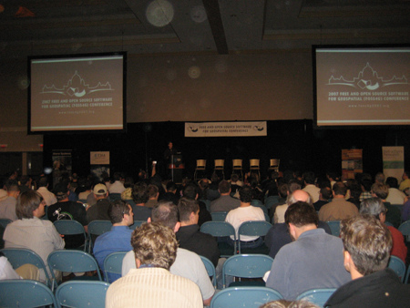
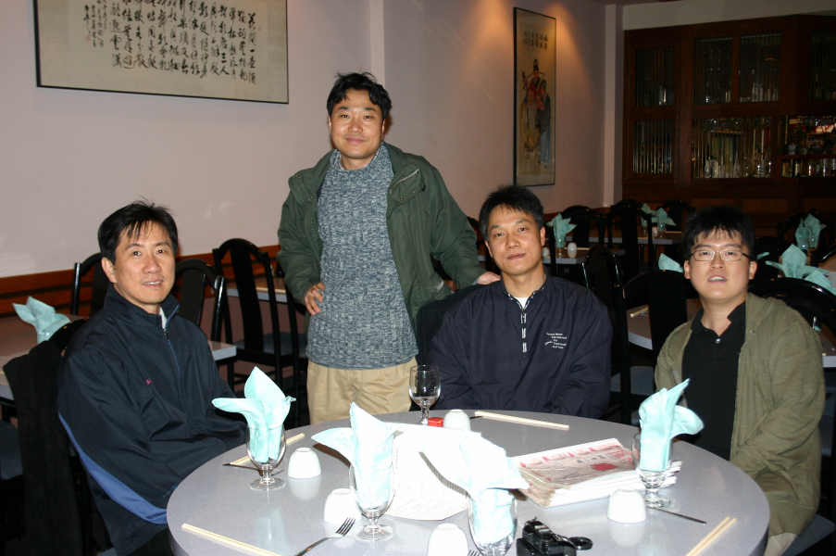
History - 2007
First discussed in FOSS4G 2007 at Victoria, Canada

Slide 6
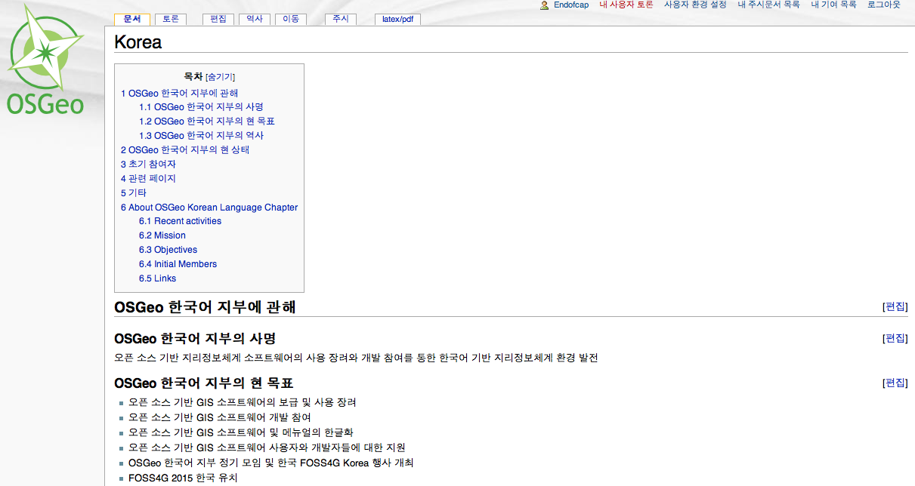
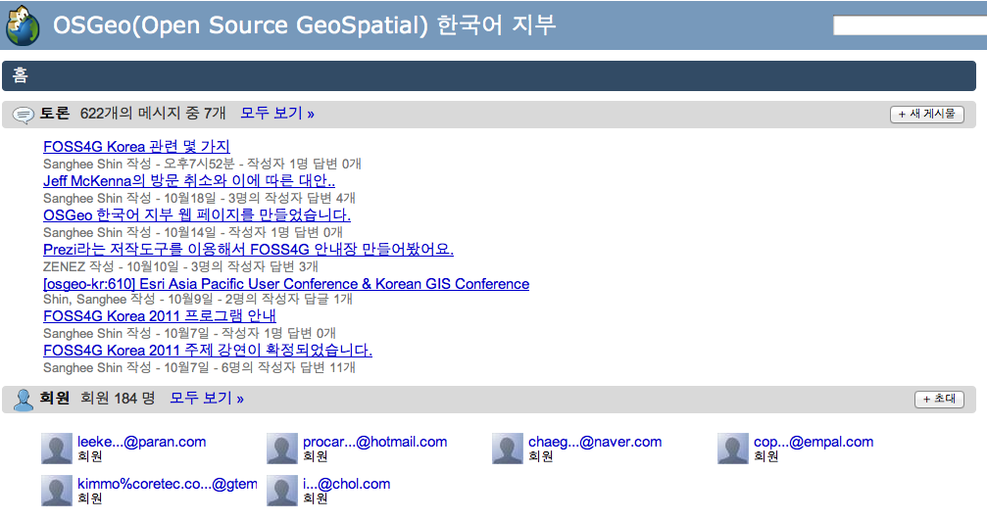
History - 2008
Feb, 2008 :
Formed unofficial OSGeo Korean language chapter
Created Wiki page for Korean chapter in OSGeo Wiki
March, 2008 :
Created Google groups mailing list

Slide 7
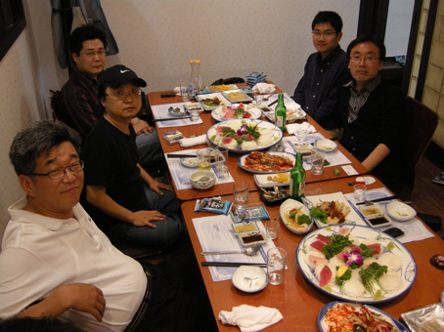
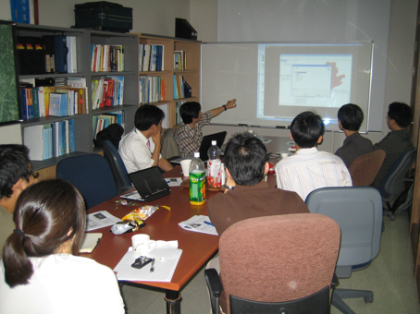
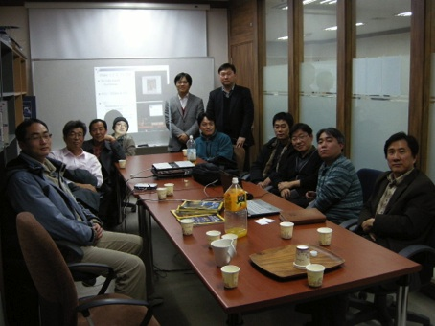
History - 2008
May, 2008 :
1st regular meeting to discuss the activities of Korean chapter
Aug, 2008 :
2nd regular meeting for technical exchange
Dec, 2008 :
3rd regular meeting for technical exchange

Slide 8
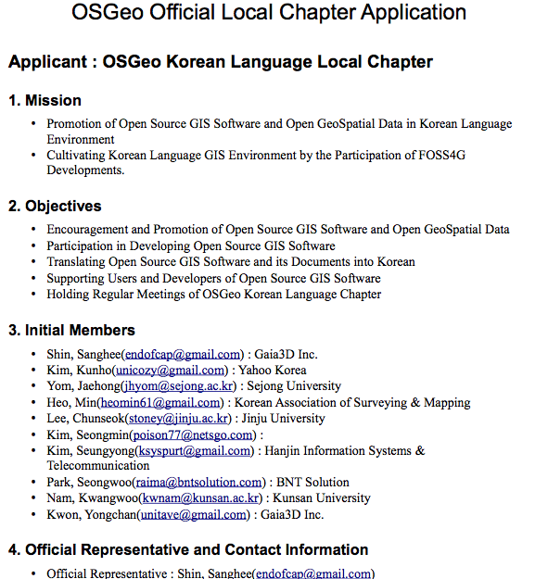
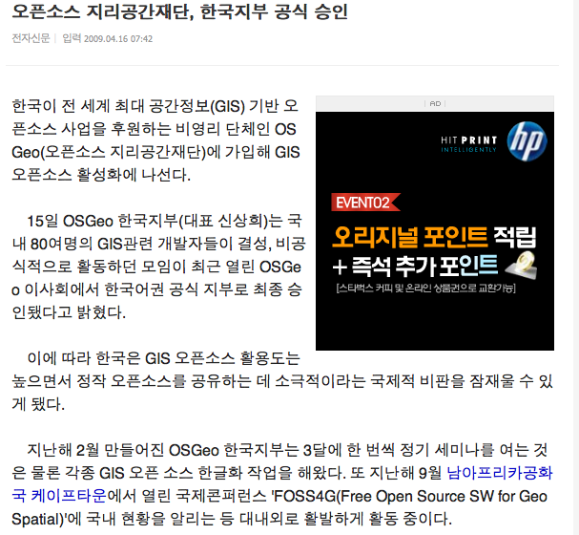
History - 2009
Moved to official OSGeo local chapter status in March!!

Slide 9
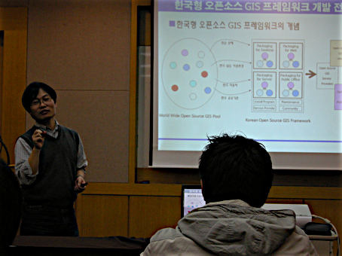
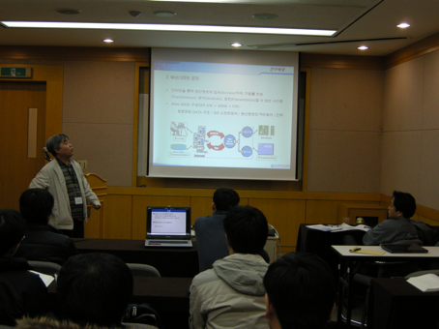
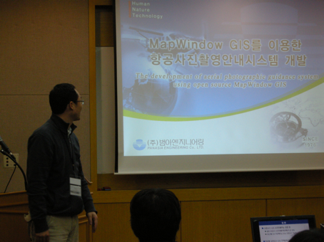
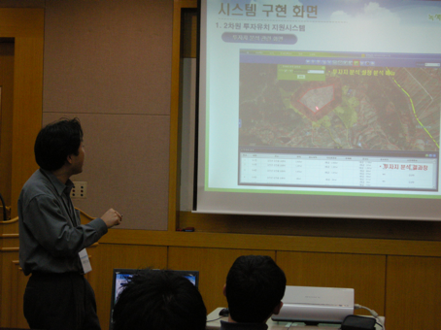
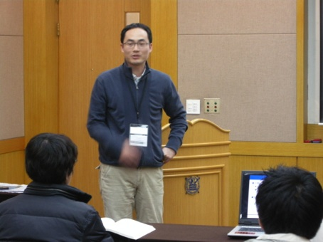
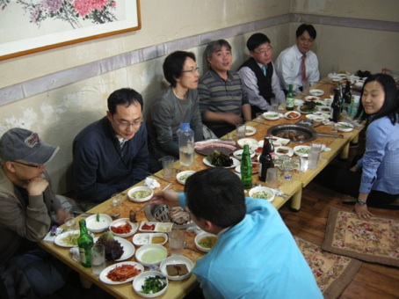
History - 2009
Organized FOSS4G special session in KSRS conference

Slide 10
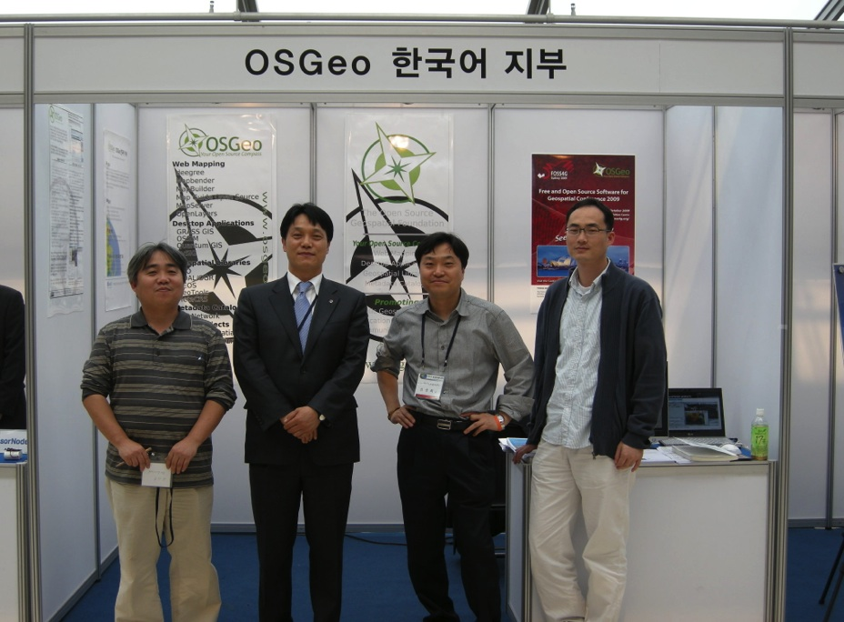
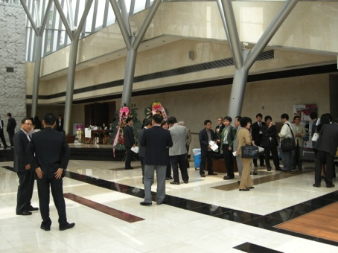
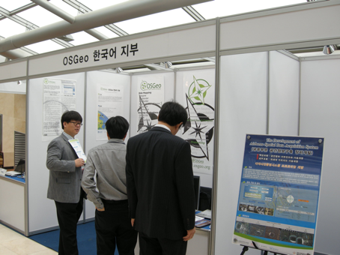
History - 2009
Opened exhibition booth at GISAK spring conference

Slide 11
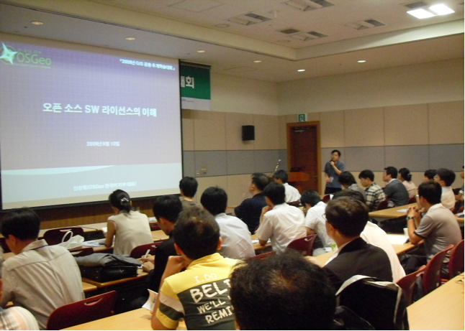
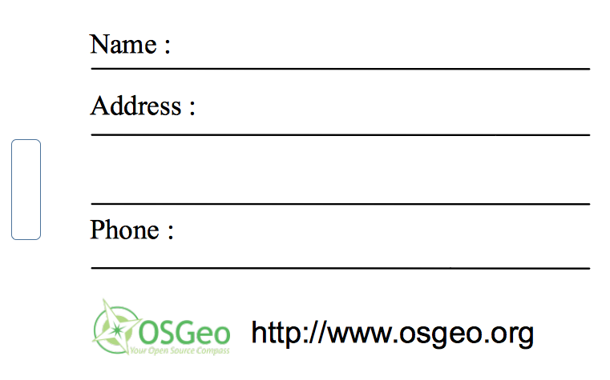
History - 2009
Organized FOSS4G special session in Smart Korea 2009

Slide 12
History - 2010
Just 1 time regular meeting in February and slept

Slide 13
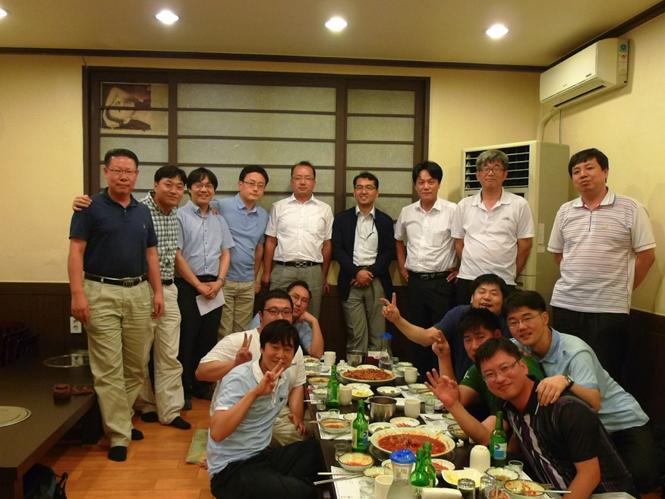
History - 2011
2 Times regular meeting
11th, Feb 2011
12th, Aug 2011

Slide 14
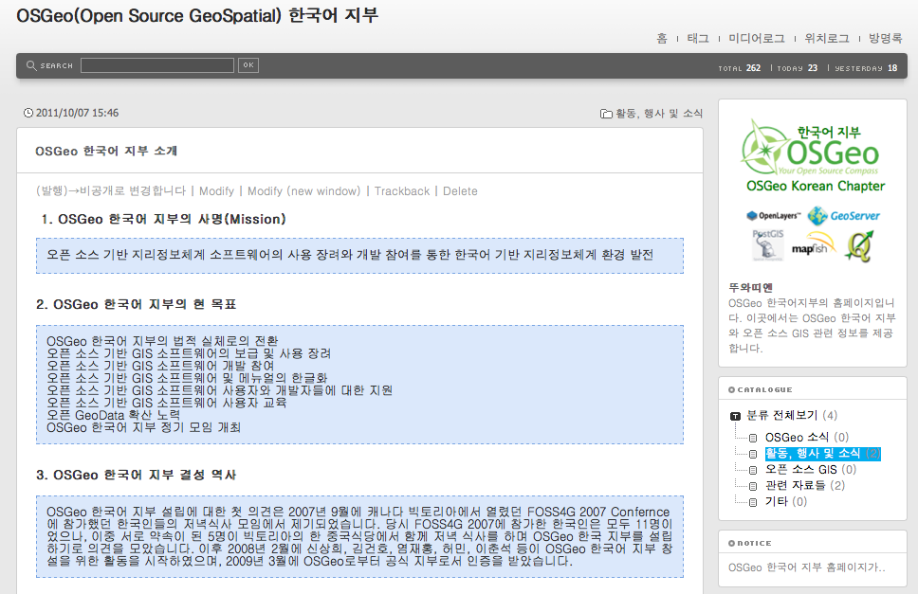
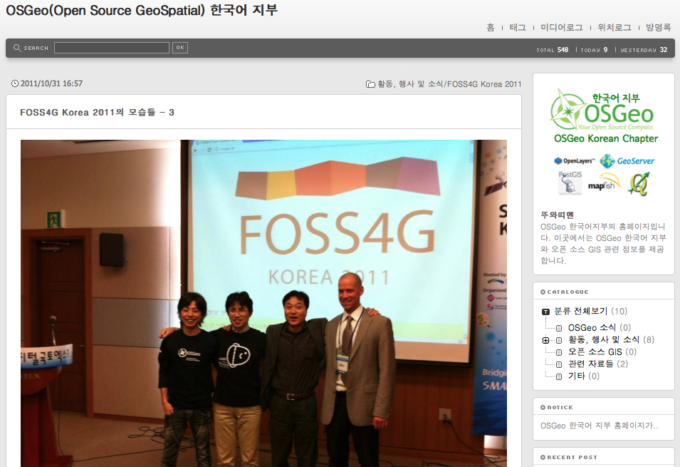
History - 2011
http://www.osgeo.kr
Created OSGeo Korean language chapter official web page

Slide 15
History - 2011
28th, Oct 2011 at KINTEX

Slide 16
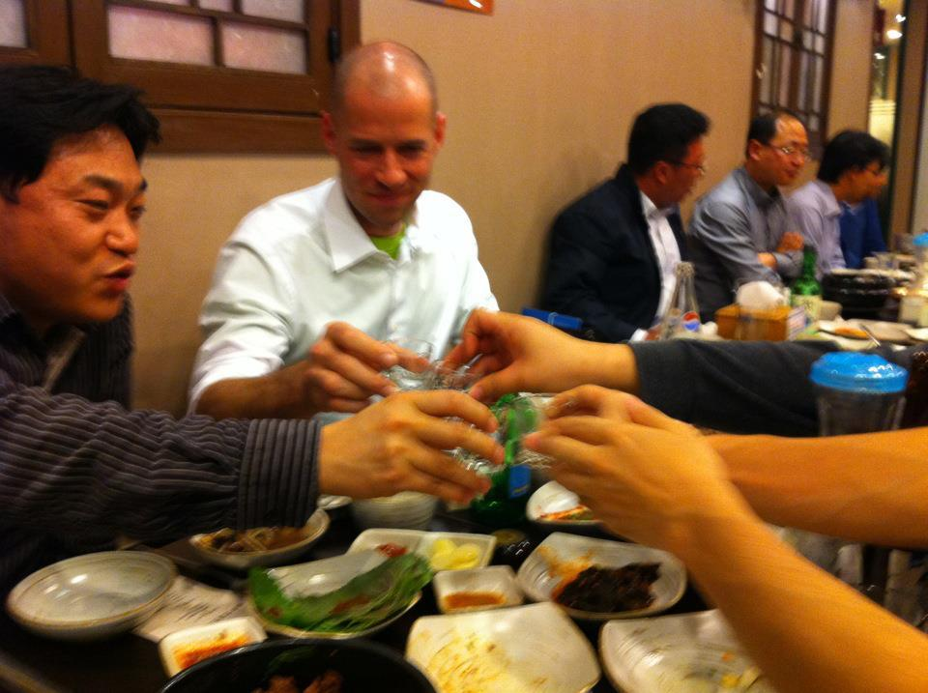
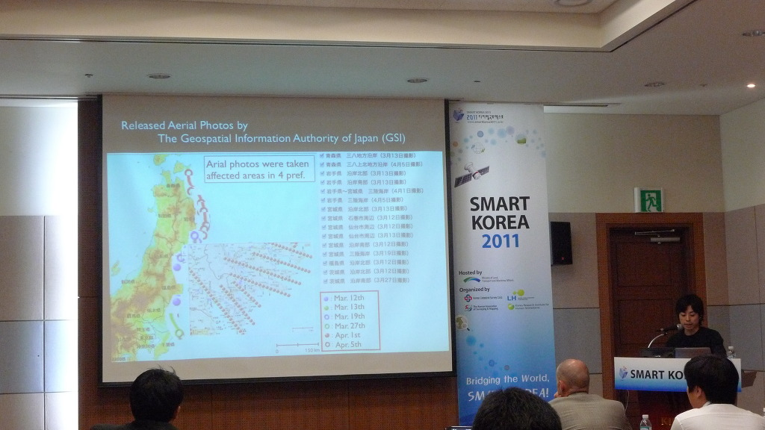
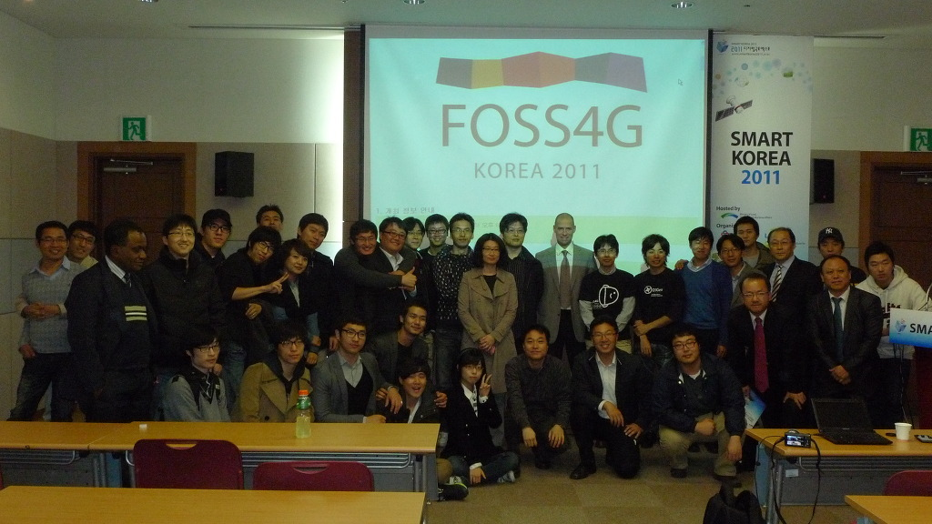
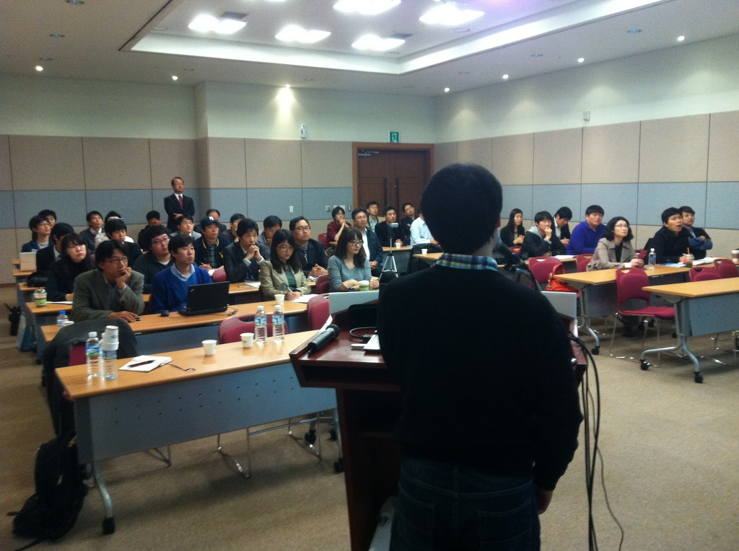
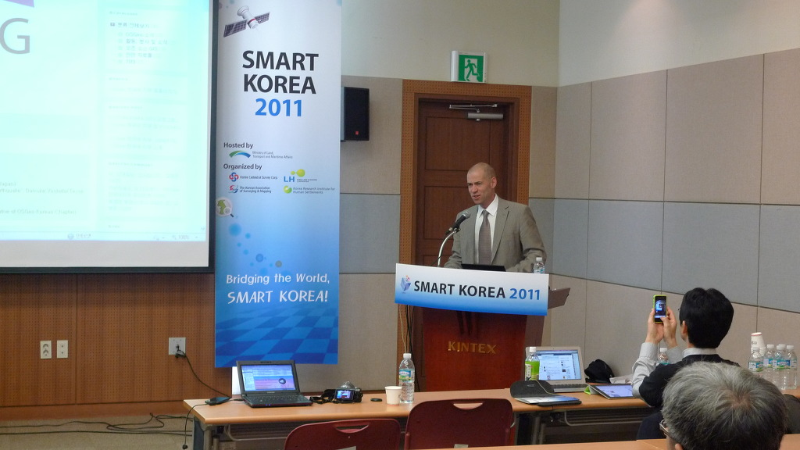
History - 2011

Slide 17
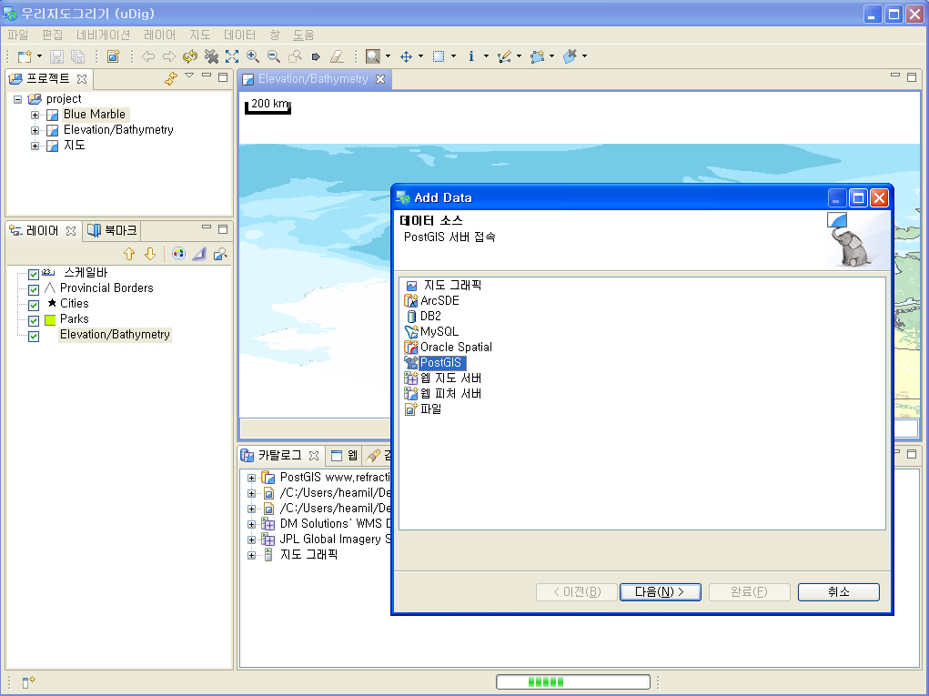
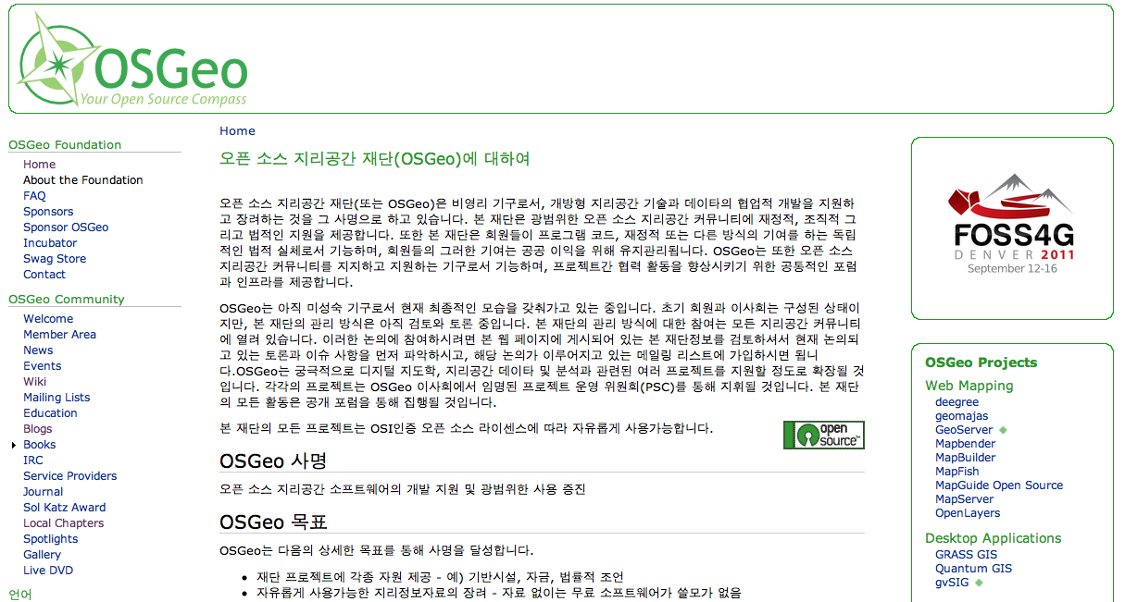
Activities
Translations & Localizations :
Translated OSGeo web pages
Translated GRASS glossary
Translated uDIG menu(Sejong University)
Translated QGIS menu
Under translation of GeoServer, PostGIS & OpenLayers manuals

Slide 18
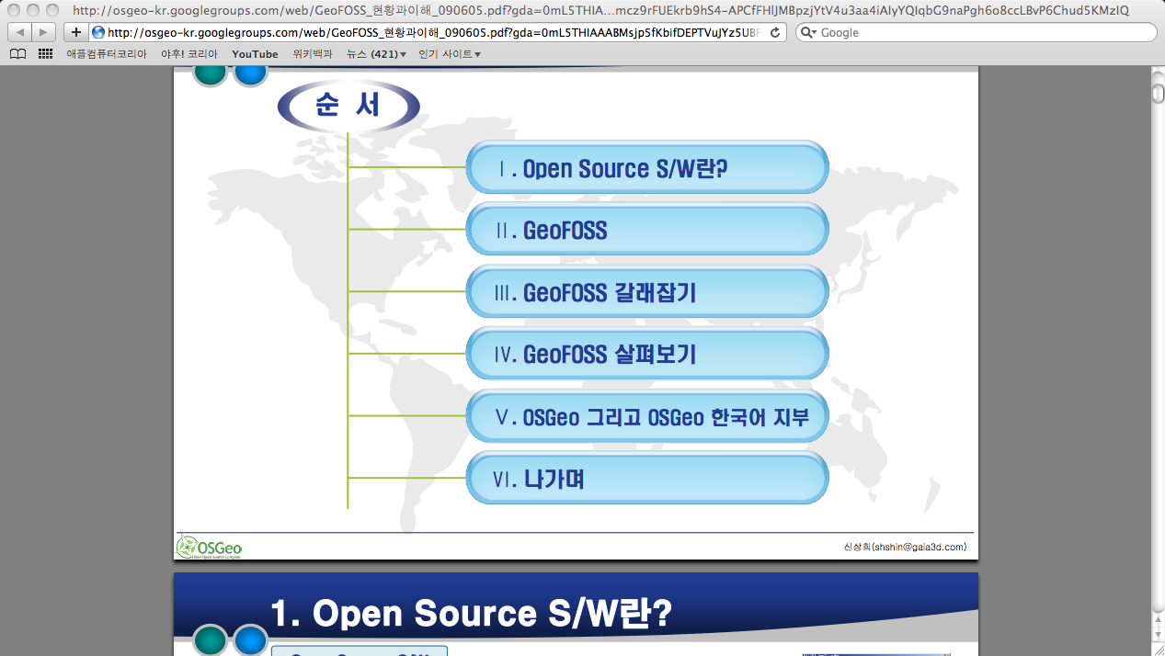
Activities
Outreach Lectures & Seminars :
Universities
Research Institutes
Companies
GIS related societies

Slide 19
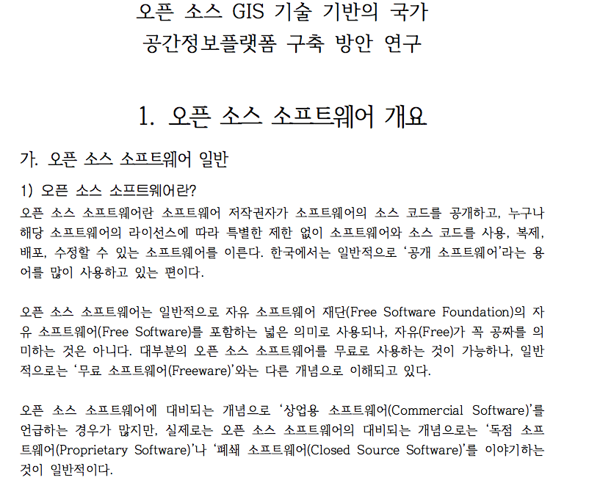
Activities
Projects :
KOPSS(Korea Planning Support System)
‘Government’s policy on open source GIS’ funded by KRIHS(Korean Research Institute of Human Settlement)
Developing open source GIS education program funded by NECGIS(National Education Center for GIS)

Slide 20
Activities
Regular Meetings :
Mainly for exchanging experiences, knowledge and technologies
2 ~ 3 times a year

Slide 21
Activities
Annual Event :
Special session or sub session of other Geo-Spatial Societies
FOSS4G Korea event as largest annual conference

Slide 22
Activities
FOSS4G Attendance :
Lausanne
Victoria
Cape Town
Sydney
Barcelona
Denver

Slide 23
Future
Changing Legal Status :
Need to convert current non-legal status to legal entity
Seeking Stable Revenue Source :
Too small revenue source to run chapter
Increasing Active Members :
Too much dependency on too small key members
Expanding Activities to International Scale
Somewhat isolated in Korea only
Hosting FOSS4G 2015 :
Need to explore the possibility of hosting FOSS4G 2015 in Korea

Slide 24
Thank you!!
Q&A

