Slide 1
한국어 지부
Let’s Grow Together!!
- An Overview of Open Source & FOSS4G -
25th, Nov, 2010
Special Lecture for Inha University
OSGeo Korean Language Chapter
Shin, Sanghee(endofcap@gmail.com)

Slide 2
Contents
I. Why Open Source?
I-1. Current Market Situation
I-2. Open Innovation & Open Business Model
II. Introduction of Open Source SW
II-1. What is Open Source SW?
II-2. Open Source SW Licenses
II-3. Benefits of Open Source SW
II-4. Growth of Open Source SW
II-5. Open Source Business Model
III. Open Source GIS
III-1. Open Source GIS?
III-2. FOSS4G Based SDI
III-3. FOSS4G Projects
III-4. Open GeoData
III-5. Korean Cases
IV. Wrapping Up
IV-1. Useful Sites

Slide 3
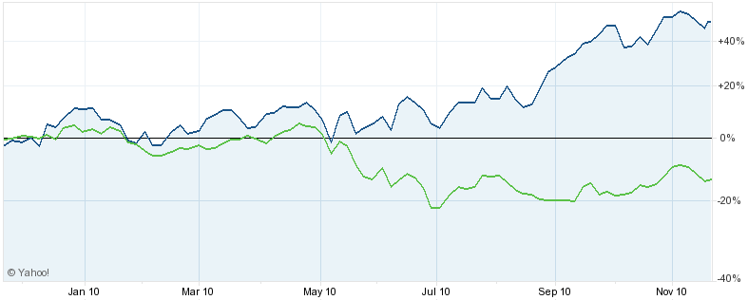
$42.67
$25.73

Slide 4
I. Why Open Source?

Slide 5
I-1. Current Market Situation
I. Why Open Source?
3 Agonies of Current Market
Stalled Growth
1
Diminishing Profit
2
Difficult Sustainability
3

Slide 6
I-1. Current Market Situation
I. Why Open Source?
7 Challenges for High-Tech Company

Slide 7
I-1. Current Market Situation
I. Why Open Source?
Difficulties of In-House R&D Success
Invested R&D 100%
Failed R&D 60%
Commercialized R&D 40%
In spite of heavy R&D investment, only 40% of R&D investment commercialized.
Among commercialized R&D, only 60% make profit.
Overall to say, only 24% of whole R&D investment make profit for the company.
Non-
Profitable 40%
Profitable 60%

Slide 8
I-2. Open Innovation & Open Business Model
I. Why Open Source?
Open Innovation
Internal
Resources
New
Value
External
Resources
Leverage smart people inside & outside of the company!!

Slide 9
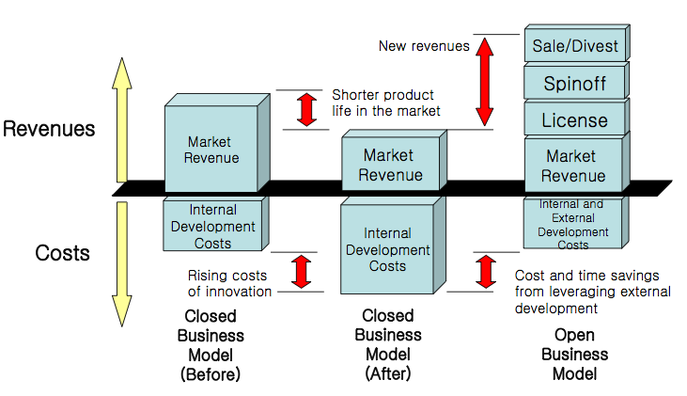
I-2. Open Innovation & Open Business Model
I. Why Open Source?
Advent of Open Business Model

Slide 10
I-2. Open Innovation & Open Business Model
I. Why Open Source?
Open Source Software
<Closed Business Model>
<Open Business Model>
Closed
Open
In-House
Development
Collaboration
Development
Leverage own knowledge
Leverage others knowledge too
Designed and developed by inside R&D lab
Inside knowledge, intellectual property, experiences
Idling knowledge, limited leveraging outside knowledge
Designed and developed with other outside partners
Inside knowledge + outside knowledge
Cost reduction + increase innovation capabilities
Leveraging inside & outside knowledge

Slide 11
II. Introduction of
Open Source SW

Slide 12
II-1. What is Open Source SW?
II. Introduction of Open Source SW
Open source SW(OSS) is the computer SW that is available in source code form under certain licenses.
Users of OSS are permitted to use, copy, study, change, improve and even redistribute those OSS freely.
‘Free’ does not mean ‘Free of Charge’ but ‘Freedom’
Freedom
Of
Software
Freedom
of
Use
Freedom
of
Redistribute
Freedom
of
Copy
Freedom
of
Modify

Slide 13
II-1. What is Open Source SW?
II. Introduction of Open Source SW
Open Source SW Criteria by OSI(Open Source Initiative)
Free Redistribution
Source Code
Derived Works
Integrity of The Author's Source Code
No Discrimination Against Persons or Groups
No Discrimination Against Fields of Endeavor
Distribution of License
License Must Not Be Specific to a Product
License Must Not Restrict Other Software
License Must Be Technology-Neutral

Slide 14
II-1. What is Open Source SW?
II. Introduction of Open Source SW
Open Source SW vs. Freeware
OSS
Freeware
Users have the right to access & modify the source codes.
In case original programmer disappeared, users & developer group of the S/W usually keep its support to the S/W.
OSS usually has the strong users & developers group that manage and maintain the project
Freeware is usually distributed in a form of binary at ‘Free of Charge’, but does not open source codes itself.
Developer of freeware could abandon development at any time and then final version will be the last version of the freeware. No enhancements will be made by others.
Possibility of changing its licensing policy
OSS is different from Freeware
Antonym of OSS would be ‘Closed Source S/W’ or ‘Proprietary S/W’
Recently OSS is also regarded as ‘Commercial S/W’

Slide 15
II-2. Open Source SW Licenses
II. Introduction of Open Source SW
Copyright vs. Licenses
Copyright
License
Set of exclusive rights granted to the author or creator of an original work, including the right to copy, distribute and adapt the work.
Rights obtained just after create the work without any registration.
Without any permissions, others could not use, copy, distribute, adapt the work.
Permission to use the work under certain agreement.
A kind of contract agreement like EULA(End User License Agreements)
If you buy Window7, it means you just buy a permission to install & use Windows7 S/W in your PC.
License is different from products buying.
IPR
Copyright
Patent
Trademark
Trade Secret

Slide 16
II-2. Open Source SW Licenses
II. Introduction of Open Source SW
Typical OSS Licenses
 | Free | Re-Distributable | Access to Source Code | Modification | Obligation to Open Derived Works | Combining with Proprietary SW
GPL | O | O | O | O | O | X
LGPL | O | O | O | O | O | O
MPL | O | O | O | O | O | O
BSD Alike | O | O | O | O | X | O
Apache Alike | O | O | O | O | X | O
GPL : Application need to be licensed under the same GPL if redistributed with the GPL asset.
LGPL : Modified library need to be licensed under the same licenses as the originating asset.
BSD/Apache Alike : Much more permissive for combination with proprietary SW.

Slide 17
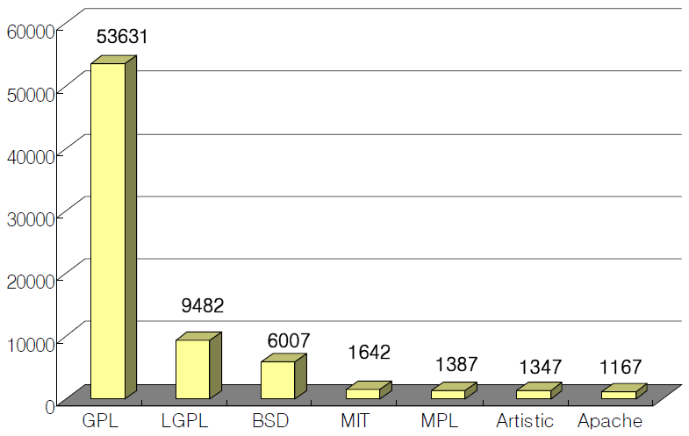
II-2. Open Source SW Licenses
II. Introduction of Open Source SW
Open Source SW Licenses Rate
Sourceforge.net, May, 2006.
Black Duck Software Knowledgebase, April, 2008.
More than 60% of OSS licenses are GPL based license.
Due to hard condition of OSS licenses, OSS is perceived to be difficult to be commercialized.
Is it really hard to commercialize the OSS?

Slide 18
II-3. Benefits of Open Source SW
II. Introduction of Open Source SW
Benefits of Open Source Software purported by OSS Community
Save money, save resources, increase stability, access to source code, access to skilled community of developers
1. Technological
Aspects
2. Economical
Aspects
3. Business
Aspects
4. Other
Aspects
Rapid development of high-class SW
Increased stability by skilled community review
Reduce technological gap to leading proprietary SW company
Internalize outside SW developer resources
Very low adoption cost
Reduce SW development cost
Easy to customize
Reuse successful story
Extend company’s products portfolio
Open up new market by providing diversified services & products
Improve brand image of company
Reduce energy
Self-Satisfaction
Help society
Develop the society by sharing technology & outcomes!!

Slide 19
II-3. Benefits of Open Source SW
II. Introduction of Open Source SW
Open Source Advantages over Commercial SW
Open source’s price tag is clearly important driver. OSS is practically cheaper than commercial one.
57% said that accessibility to source code really matters and 41% cited community code review as an important benefit over proprietary.
Price & open source code are key factors!
* Source : Barracuda Networks

Slide 20
II-4. Growth of Open Source SW
II. Introduction of Open Source SW
Forecast of Open Source SW Growth
“By 2012, open-source software's impact on application software will grow to $19 billion, with a five-year compound annual growth rate of 44%.”, 2008
“By 2012, 80 per cent of all commercial software will include elements of open-source technology”, 2008
“Worldwide revenue from open source software will grow at a 22.4 percent compound annual growth rate to reach $8.1 billion by 2013.”, 2009
“Large software vendors like IBM, Sun, Dell, HP, and Oracle are making significant amounts of indirect revenue from their activities with and support of OSS.”, 2009
“The notional value of Europe’s investment in FLOSS software today is Euro 22 billion (36 billion in the US) representing 20.5% of total software investment (20% in the US)”, 2007
“FLOSS-related services could reach a 32% share of all IT services by 2010, and the FLOSS-related share of the economy could reach 4% of European GDP by 2010.”, 2007

Slide 21
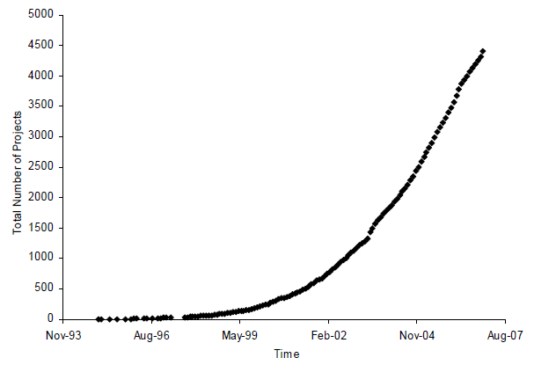
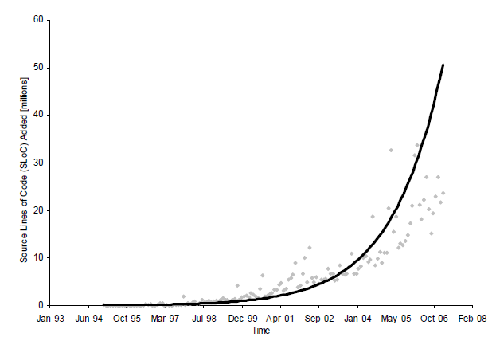
II-4. Growth of Open Source SW
II. Introduction of Open Source SW
Trends of Open Source Software Growth
With cumulative growth of open source software, open source software has now reached a turning point or tipping point in terms of adoption of open source software and business.
<FOSS Projects Growth>
<FOSS Source Codes Growth>
* Source : Amit Deshpande et al , 2008, “The Total Growth of Open Source”, In Proceedings of the Fourth Conference on Open Source Systems (OSS 2008).

Slide 22
II-5. Open Source Business Model
II. Introduction of Open Source SW
Combining Advantages of Proprietary and Open Source Model into ‘Commercial’ Model
Commercial Open Source Software
Advantages
of
Proprietary
Professional service
Continuous support
Easy to use
Reliability
Functionalities
Advantages
of
Open Source
Cheaper price
Source code access
Community review
Quicker bug fix
More standard based
‘Whole Product’
Commercial open source company can exist to create ‘Whole Product’ around an open source project (software + community) and can deliver it to a mainstream market.

Slide 23
II-5. Open Source Business Model
II. Introduction of Open Source SW
‘Commercial’ Open Source Business Model as Platform Business
Community can hear more functionalities & requests
+
The bigger community
the more resources
Commercial Open Source Company
Open
Source
Software
Community
‘Go To Market’
Sales, Marketing, Support, Services, Engineering, Product Mgmt.
Customers
Partners
OEMs
+
+
Customers can gain higher quality software at a better price

Slide 24
II-5. Open Source Business Model
II. Introduction of Open Source SW
Ecosystem of ‘Commercial’ Open Source Business Model
Commercial
Open Source Business
Model

Slide 25
II-5. Open Source Business Model
II. Introduction of Open Source SW
Value Chain Change
Current Proprietary Model
Software
Whole Product
Channel
Customers
Software 1
Channel
Customer 1
Software 2
‘Whole Product’
Customer 2
Software 3
Customer 3
In-house
In-house & partners
Outside
Cost Side
Cost Side
Money Side

Slide 26
II-5. Open Source Business Model
II. Introduction of Open Source SW
Value Chain Change
Commercial Open Source Model
Software
Whole Product
Channel
Customers
VA Software
Channel
Customer 1
Community
Customer 2
‘Whole Product’
Customer 3
Community
In-house
In-house & partners
Outside
Money Side
Cost Side
Cost Side
Money Side

Slide 27
III. Open Source GIS

Slide 28
III-1. Open Source GIS?
III. Open Source GIS
Open Source GIS
FOSS4G : Free Open Source Software for Geo-Spatial
GeoFOSS : Geo Free Open Source Software

Slide 29
III-1. Open Source GIS?
III. Open Source GIS
Characteristics of GIS : Vertical Set of Many Software
Client
ArcMAP
Google Earth
QGIS
Web
Interface
WMS
WFS
WCS
CSW
Middleware
ArcTMS
TMS
GeoWebCache
Server
ArcServer
ArcSDE
GeoServer
MIP
DBMS
Oracle
PostgreSQL
Data
Map
Image
DEM

Slide 30
III-1. Open Source GIS?
III. Open Source GIS
FOSS4G as Substitute for Proprietary Software
ArcReader
ArcMap/ArcGIS
ArcINFO/ArcGRID
ArcPad
ArcSDE
ArcIMS
ArcGIS Server
VB, Python
Viewing
uDig, GRASS, gvSIG, QGIS, OSSIM
uDig, GRASS, gvSIG, QGIS, OSSIM
GRASS, OSSIM, SEXTANTE
gvSIG mobile
PostGIS
Mapserver, GeoServer
GRASS, SEXTANTE
PHP, Python, Perl, C#.net, etc…
Cartography
Analysis
Devices
Database
Web
Spatial Server
Scripting
Source : “오픈 소스 GIS 소프트웨어와 표준”, 남광우

Slide 31
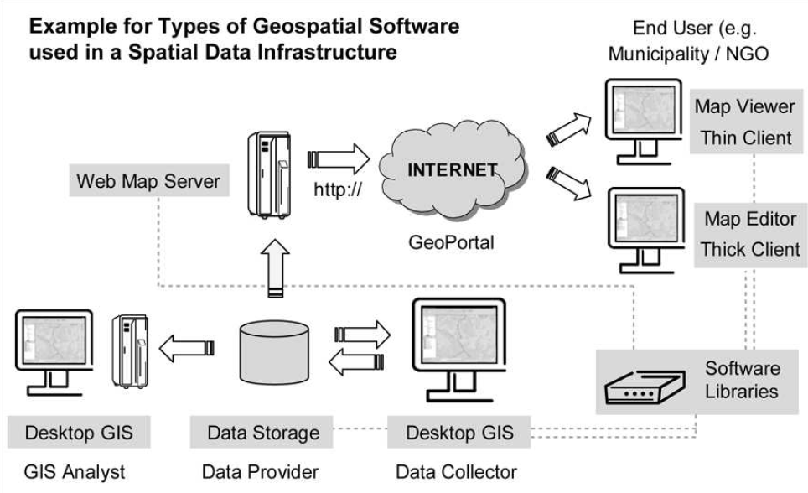
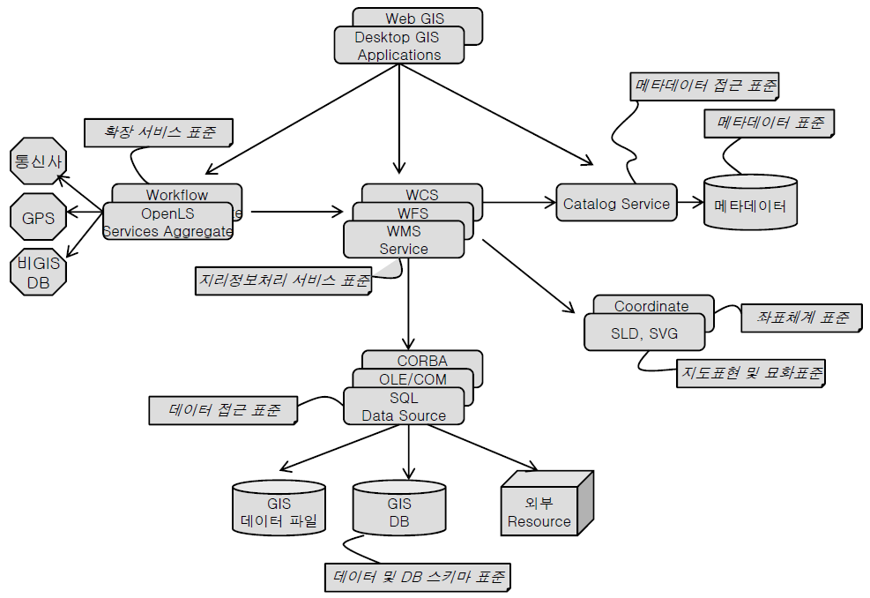
III-2. FOSS4G Based SDI
III. Open Source GIS
SDI Architecture
STEFAN STEINIGER et al, 2008, “An overview of Current Free and Open Source Desktop GIS Developments”
남광우, “오픈 소스소프트웨어와 표준”

Slide 32
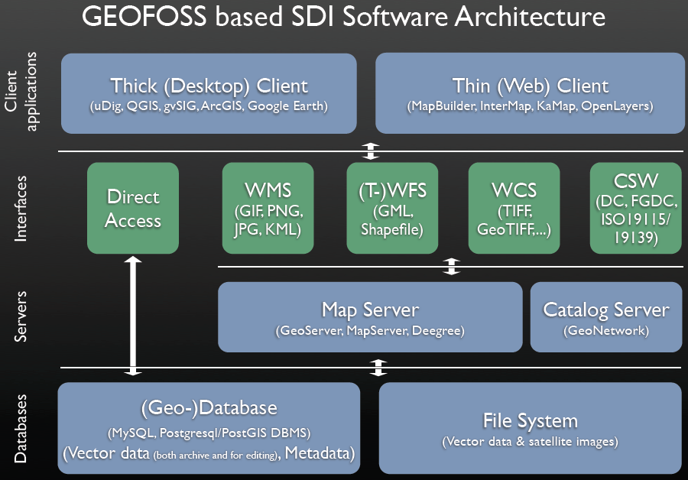
III-2. FOSS4G Based SDI
III. Open Source GIS
FOSS4G Based SDI Architecture

Slide 33
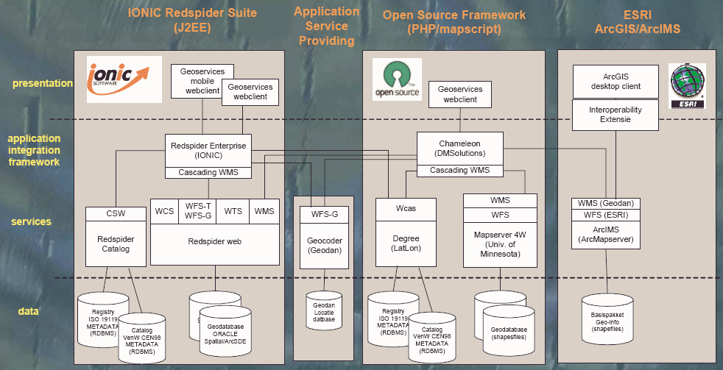
III-2. FOSS4G Based SDI
III. Open Source GIS
Combination of Proprietary & FOSS4G
EU : INSPIRE

Slide 34
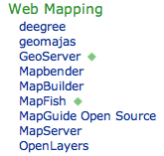
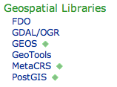
III-3. FOSS4G Projects
III. Open Source GIS
FOSS4G Projects under OSGeo Umbrella

Slide 35
III-3. FOSS4G Projects
III. Open Source GIS
C Tribe
TerraLib
PostGIS
MapGuide
GEOS
OSSIM
GRASS
OGR/GDAL
Mapserver
Proj4
QGIS
FDO
GMT

Slide 36
III-3. FOSS4G Projects
III. Open Source GIS
Java Tribe
gvSIG
GeoAPI
OpenMap
uDig
GeoTools
GeoServer
JUMP
JTS Topology Suite
DeeGree

Slide 37
III-3. FOSS4G Projects
III. Open Source GIS
.Net Tribe
MapWindow
Proj4
Proj.Net
WorldWind
NTS
JTS
SharpMap
GDAL
OGR

Slide 38
III-3. FOSS4G Projects
III. Open Source GIS
Web Tribe
Ka-Map
CartoWeb
Mapserver
MapBender
WMS
MapBuilder
OpenLayers
TileCache
FeatureServer
PostGIS
GeoExt
MapFish
Geoserver
OpenScales
ExtJS

Slide 39
III-3. FOSS4G Projects
III. Open Source GIS
FOSS4G Ecosystems
QGIS
Map Window
Open Layers
GeoExt
Client
uDIG
World Wind
Open Scales
Map Fish
OWS Interface
Middleware
Squid
TMS
GeoWebCache
Server
MapServer
MapGuide
GeoServer
Deegree
GRASS
GeoNetwork
DBMS
PostgreSQL + PostGIS
Data
Open Street Map
Open Aerial Map
GeoNames

Slide 40
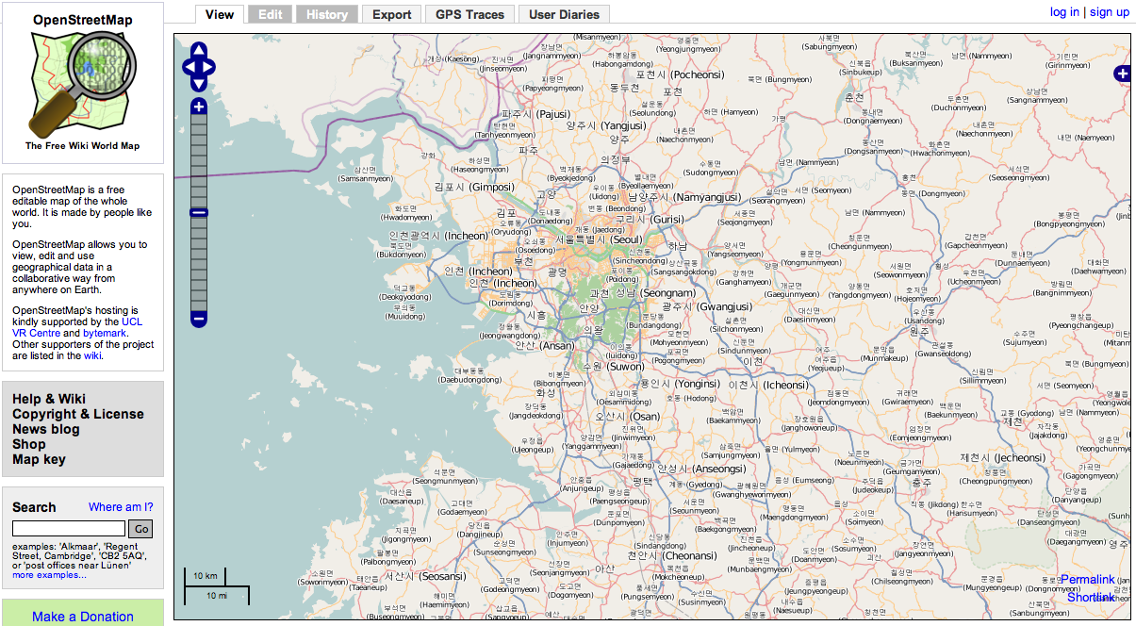
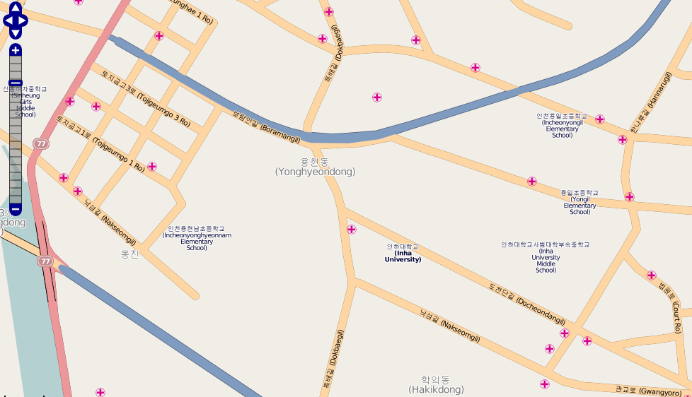
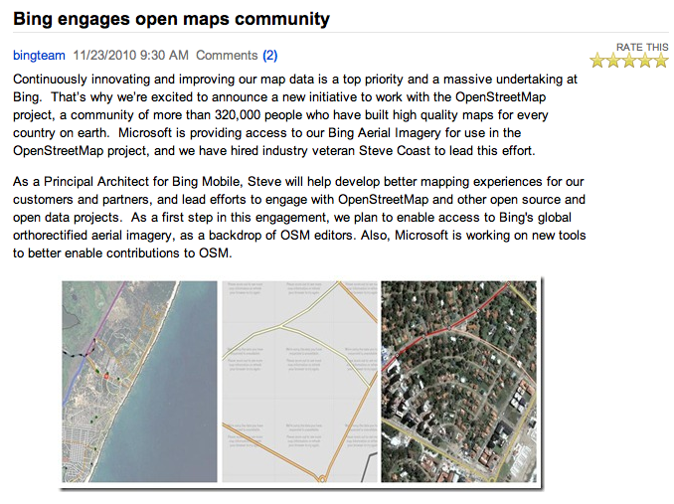
III-4. Open GeoData
III. Open Source GIS
Open Street Map
OSM is made & published by people’s participation!!

Slide 41
III-5. Korean Cases
III. Open Source GIS
FOSS4G Adoptions in Korea

Slide 42
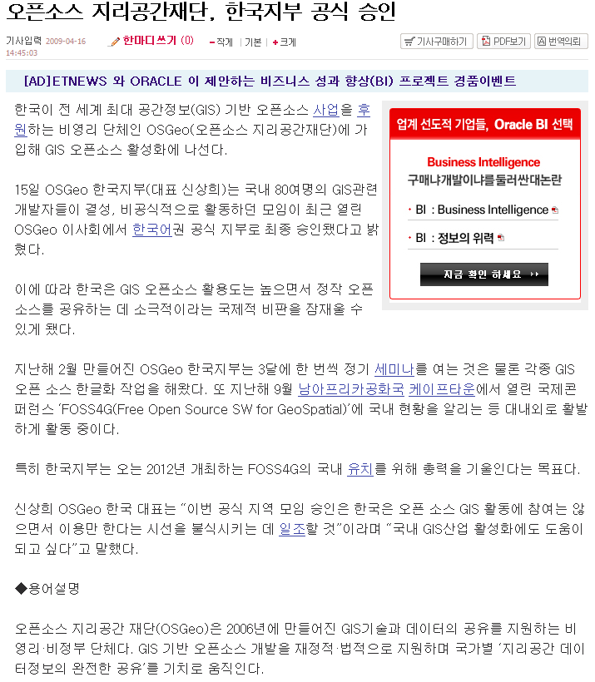
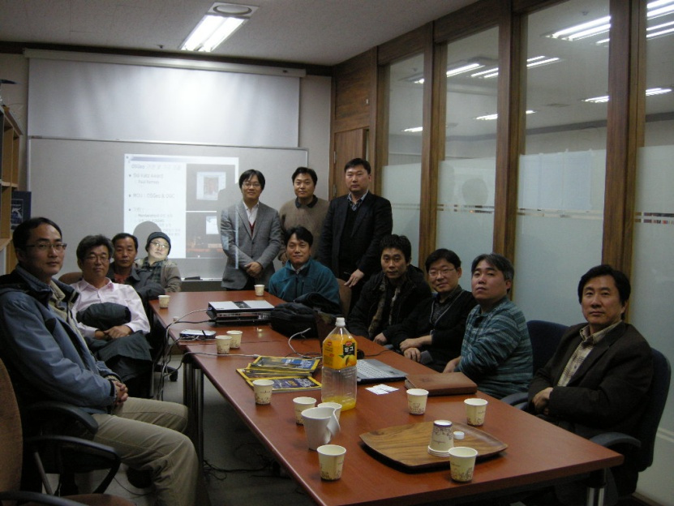
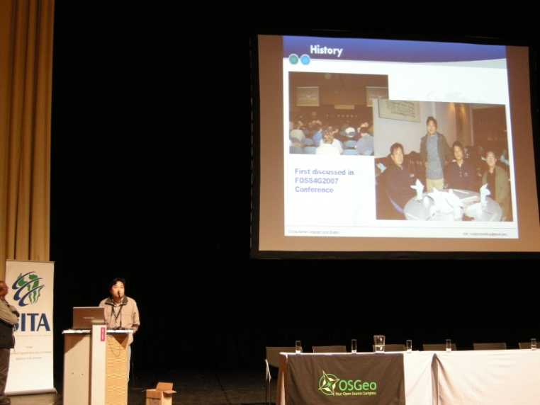
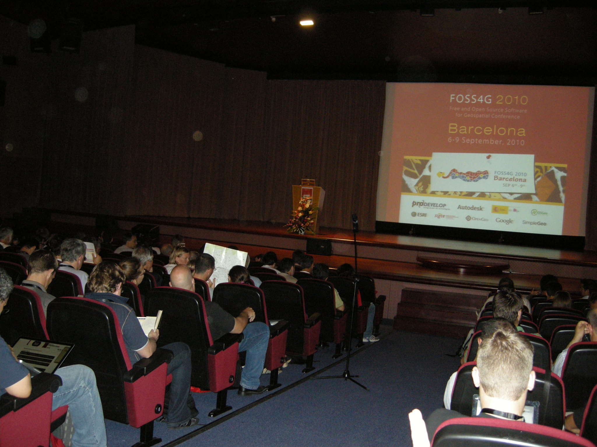
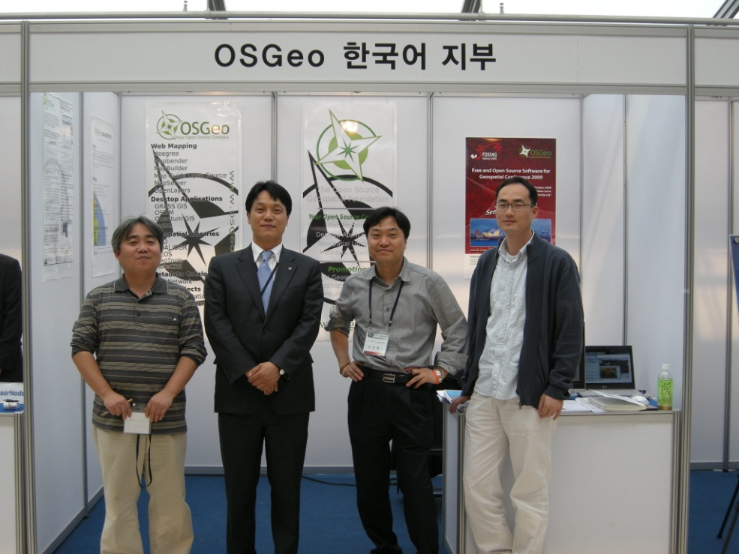
III-5. Korean Cases
III. Open Source GIS
OSGeo Korean Language Chapter

Slide 43
IV. Wrapping Up

Slide 44
IV-1. Useful Sites
IV. Wrapping Up
FOSS4G Related Sites
OSGeo
http://www.osgeo.org : NGO Foundation for FOSS4G
The FreeGIS Project
http://www.freegis.org : Free GIS S/W, Geo-Data, Materials
Open Source GIS
http://www.opensourcegis.org : Link page to FOSS4G

Slide 45
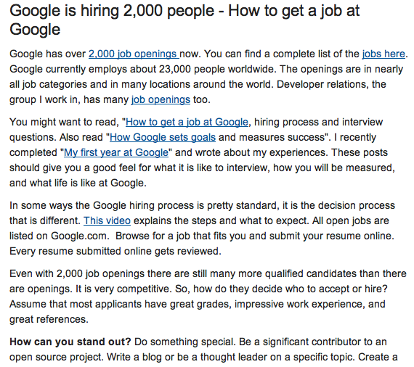

Slide 46
한국어 지부
Q&A

